Slide 1
INTEL PRODUCTS SENTIMENT ANALYSIS FROM ONLINE REVIEWS
Name: Nidhi G
USN: 1BI21 CS082
Department of Computer Science and Engineering
Bangalore Institute of Technology
K.R. Road, V.V.Puram, Bangalore-560 004

Slide 2
Collection of Data
In this project, Playwright library of python is utilized to extract data from Amazon. Specifically, leveraging the “async_playwright” module, which integrates with “asyncio” for asynchronous web scraping.
Features of data:
Product name - “ Intel Core I9-14900K LGA 1700 New Gaming Desktop Processor 24 Cores (8 P-Cores + 16 E-Cores) with Integrated Graphics – Unlocked “
Rate – “ 5.0 out of 5 stars ”
Review Date –“ Reviewed in India on 20 November 2023”
Review Text – ”Fast shipping. Works as advertised. ”
Patter Name- “Pattern Name: ProcessorStyle Name: Core™ i9-14900k ”
Product MRP – “ ₹82,350”

Slide 3
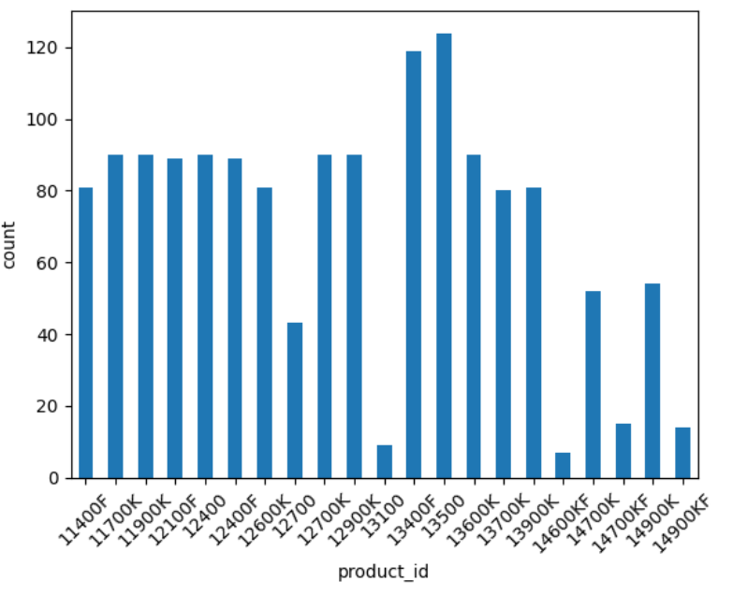
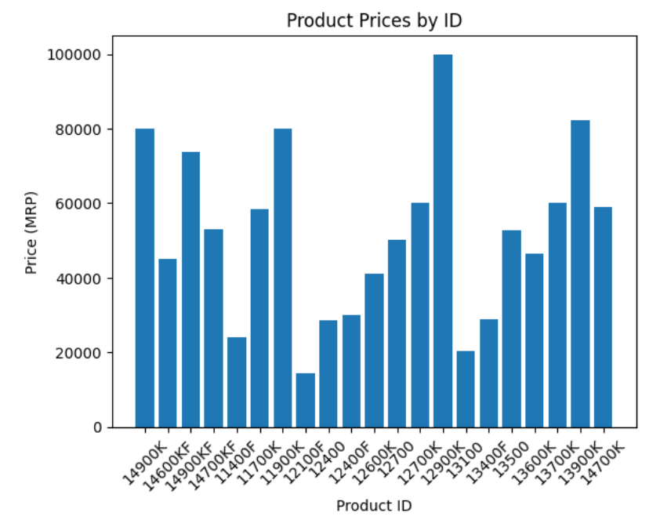
Analysis of the Data
Number of reviews for each product
MRP of different Products

Slide 4
Sentiment Analysis Approach
For sentiment analysis and classification in this project, the VADER model, a rule-based approach using a lexicon of words with sentiment scores, and the RoBERTa model, a deep learning approach based on the Transformer architecture fine-tuned for sentiment tasks, have been used.
VADER provides quick, lexicon-based sentiment analysis, while RoBERTa leverages contextual representations from extensive text data for more nuanced insights.

Slide 5
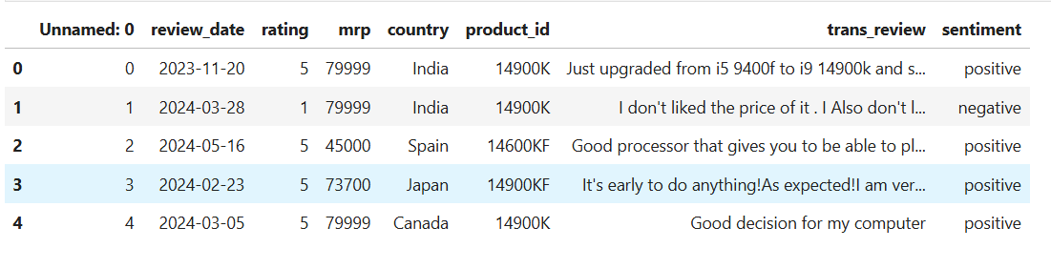
Results after classification using the models
The following shows a part of classified reviews

Slide 6
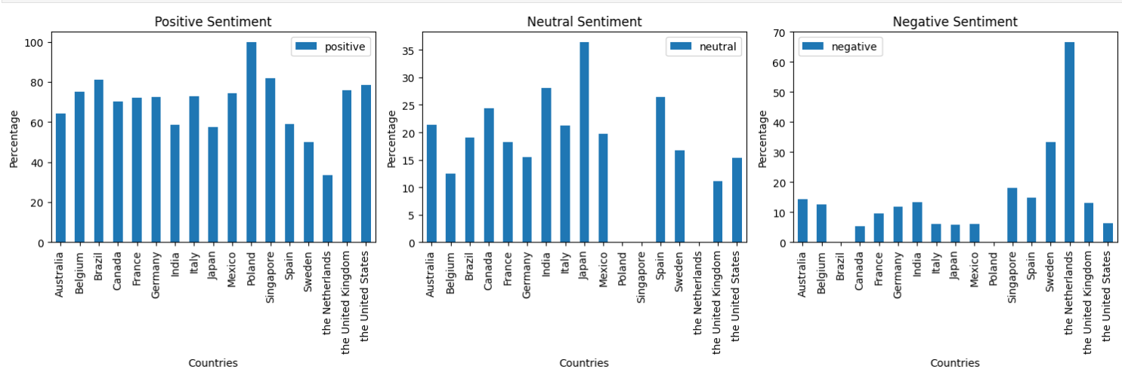
Conclusions based on classification
Comparing reviews from different countries

Slide 7
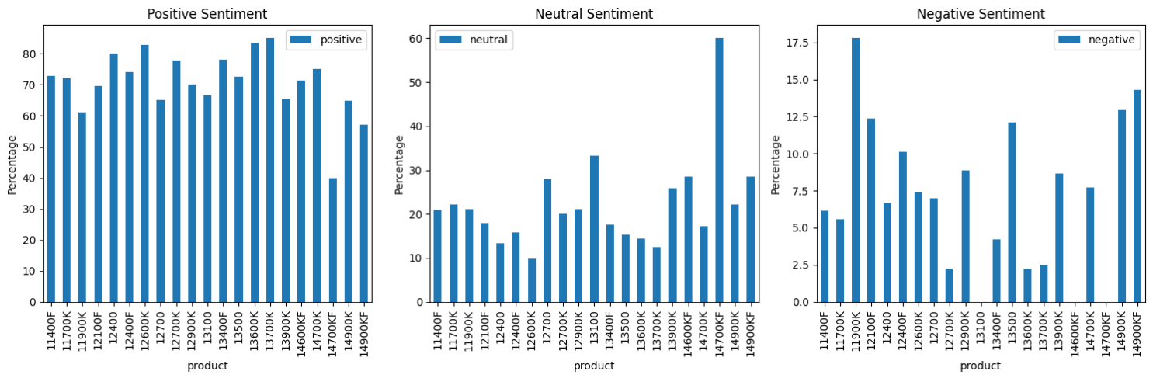
Review of each product vs their sentiment

Slide 8
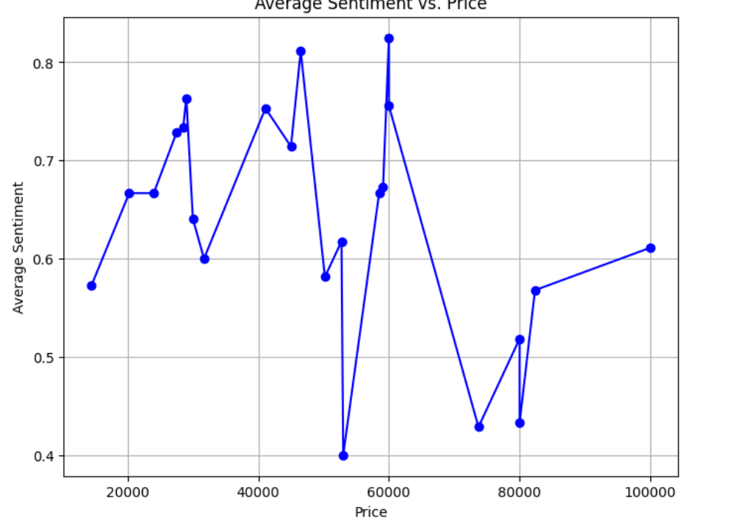
Sentiment of the product and price of the product

Slide 9
Thank you

